Slide 1

Introduction to Robotics
CSE 461
Lecture 2: Chapter 1(Introduction to robotics: basics)
Md Toki Tahmid
Lecturer, Dept. of Computer Science and Engineering
Brac University
Thanks to-
Riad Ahmed
Lecturer, Dept. of Computer Science and Engineering
Brac University
Notes:
Laws of robotics
4D→ When to use robot
Thumb Rules on the decision of a Robot Uses
Some Special Vehicles
Primitives of robotics
Paradigms of robotics

Slide 2
Law of Robotics
1. A robot must not harm human being, nor through in action allow one to come to harm.
2. A robot must always obey human beings, unless that is in conflict with the first law.
3. A robot must protect from harm, unless that is in conflict with the first two laws.
4. A robot always should have a kill switch.

Slide 3
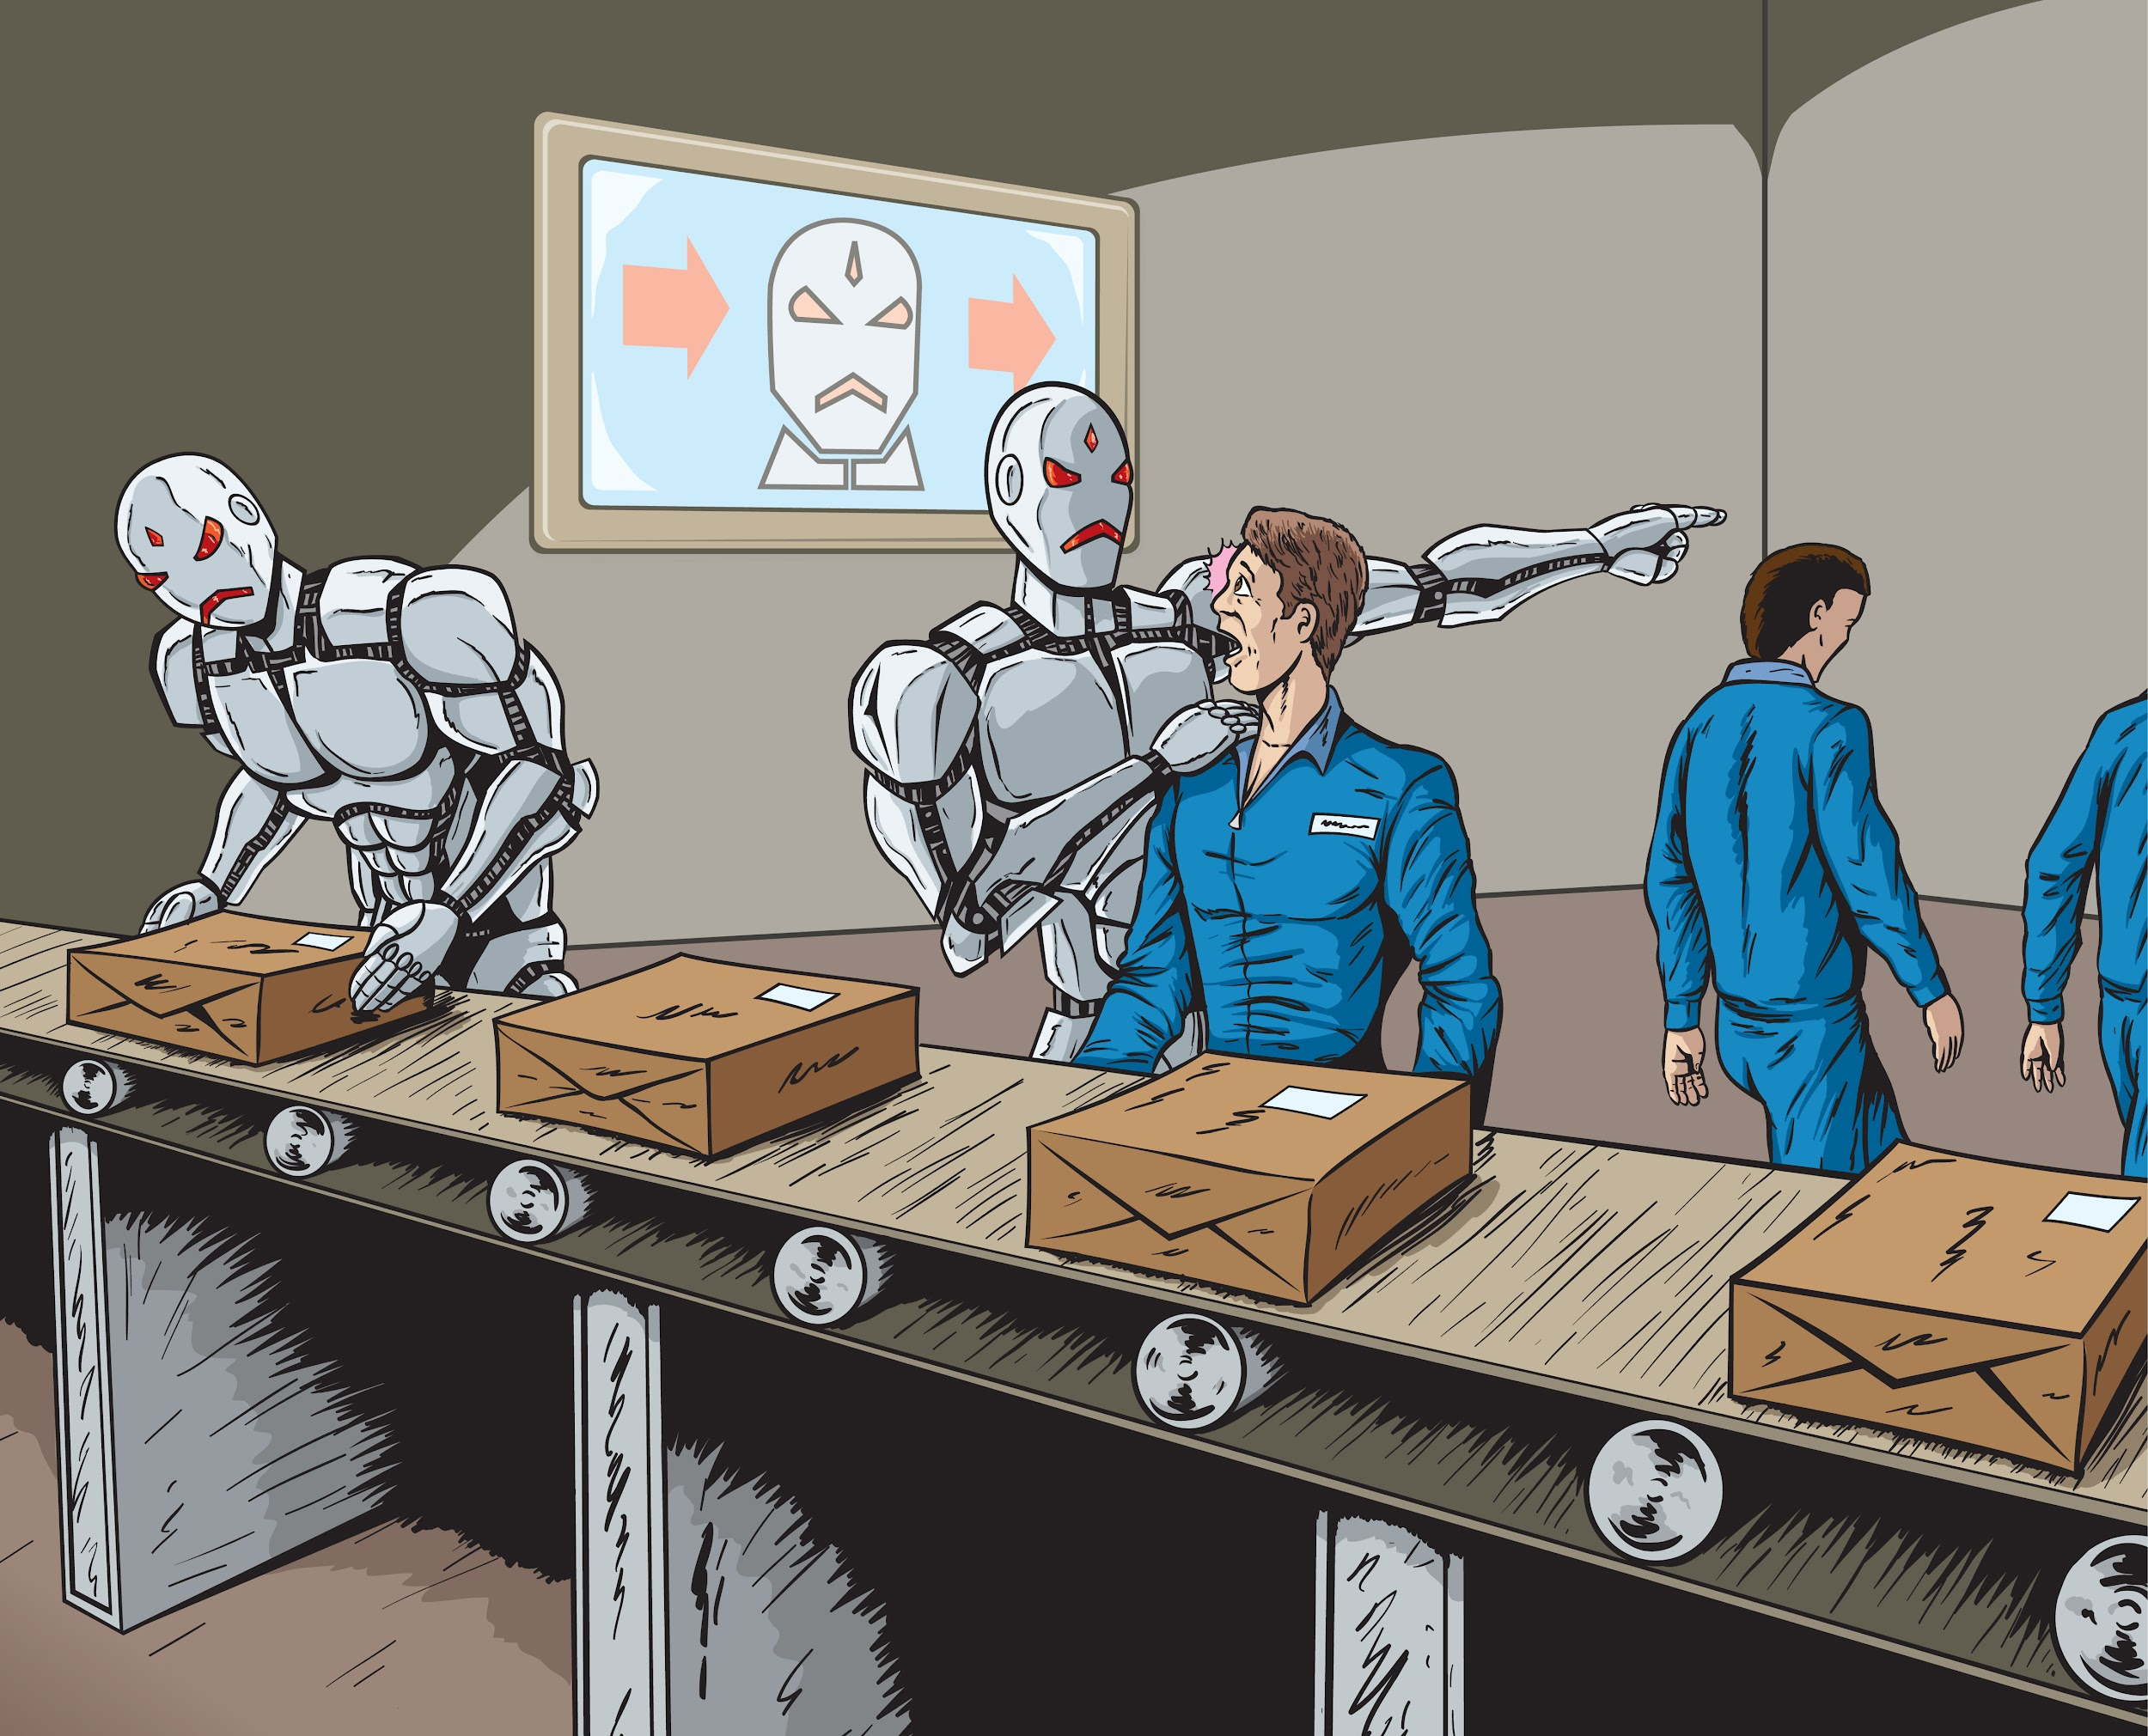
Will robots make
people Jobless ?

Slide 4
Uses of robots
4D

Slide 5
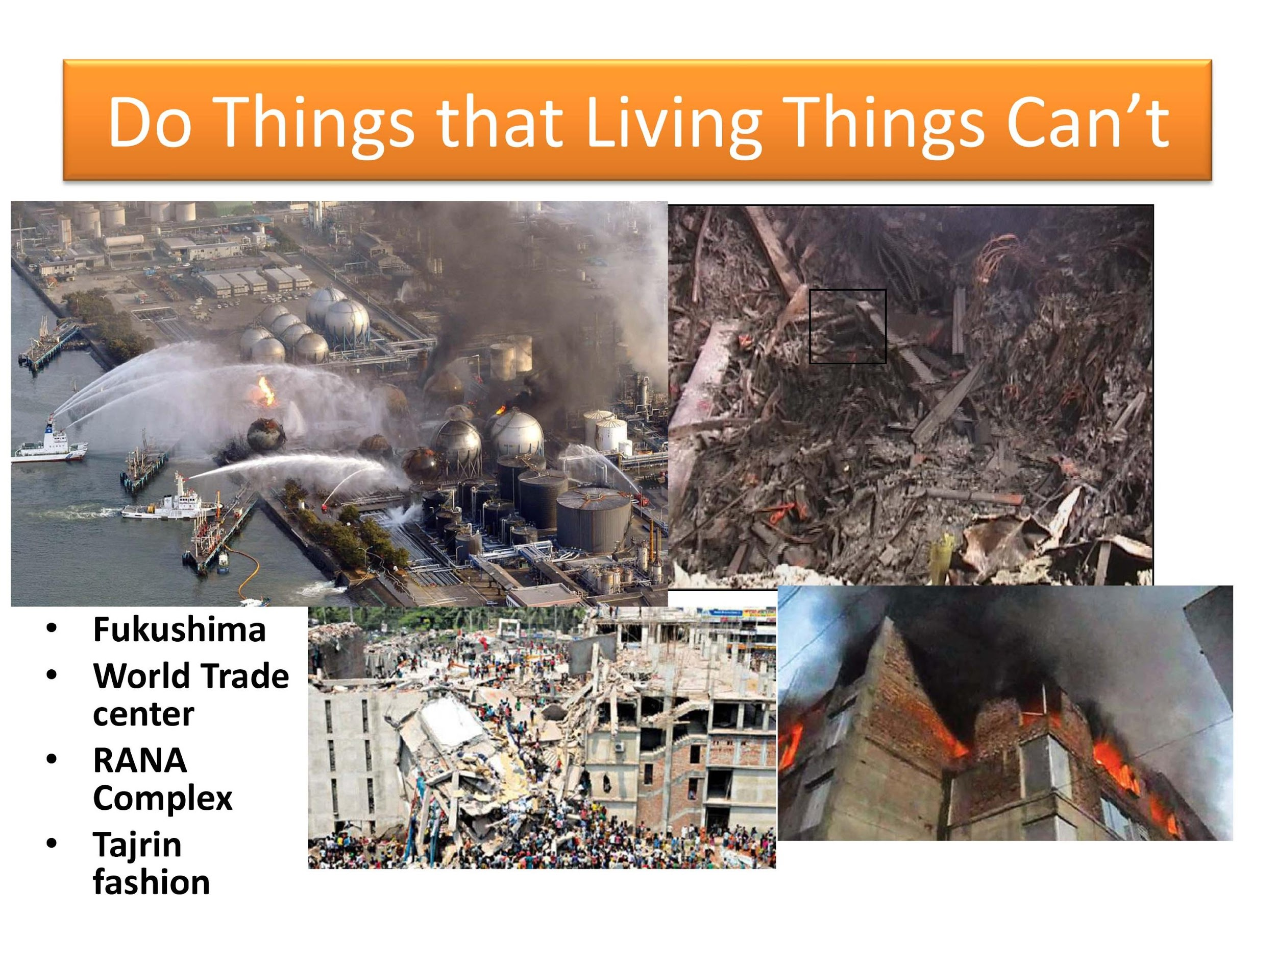

Slide 6
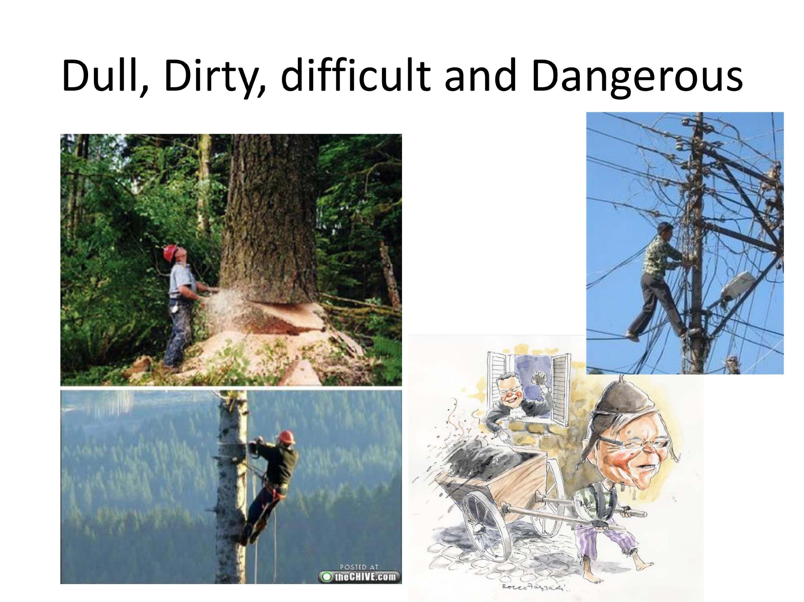

Slide 7
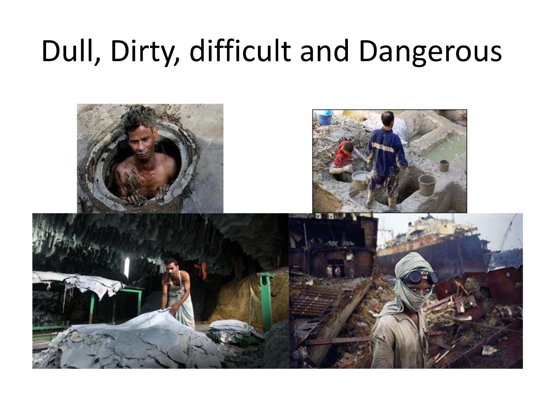

Slide 8
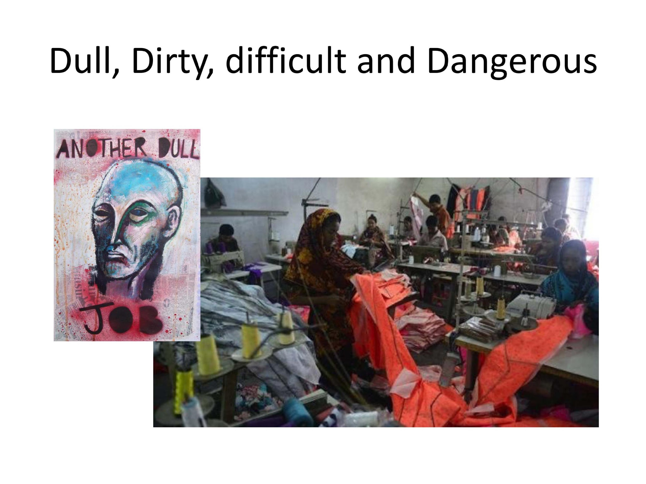

Slide 9
Thumb Rules on the decision of a Robot Uses
The first rule to consider, what is known as the Four D of Robotics, i.e. is the task dirty, dull, dangerous, or difficult? If so, a human will probably not be able to do the job efficiently. Therefore, the job is appropriate for automation or for robotic labor.
The second rule is that a robot may not leave a human jobless. Robotics and automation must serve to make our lives more enjoyable, not miserable.
A third rule involves asking whether you can find people who are willing to do the job. If not, the job is a candidate for automation and Robotics.
A four rule of thumb is that the use of robots or automation must make short-term and long-term economic sense.

Slide 10
Some Special Vehicles

Slide 11
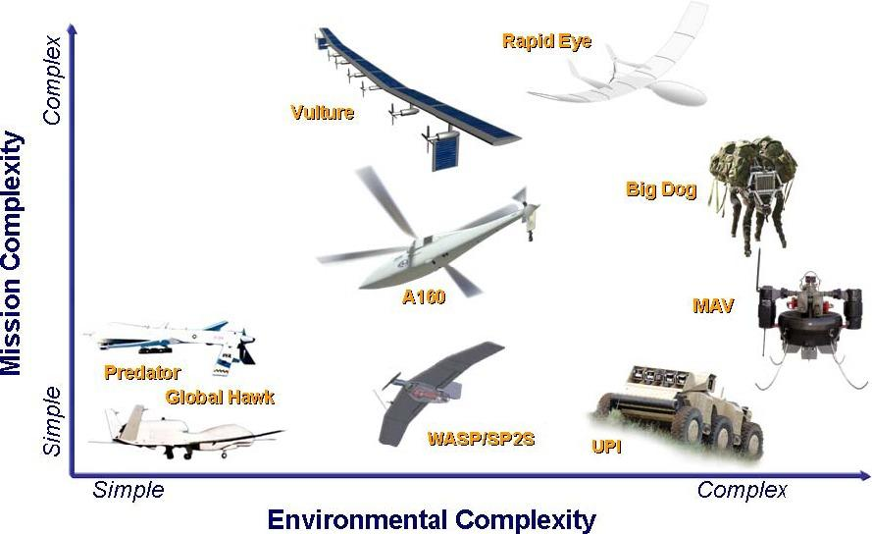
Uncrewed Vehicle
An uncrewed vehicle, also known as an unmanned vehicle or an autonomous vehicle, refers to a vehicle that operates without human presence onboard.

Slide 12
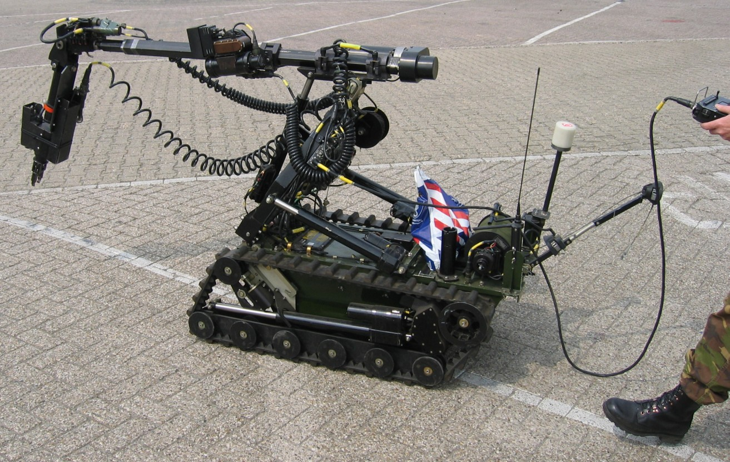
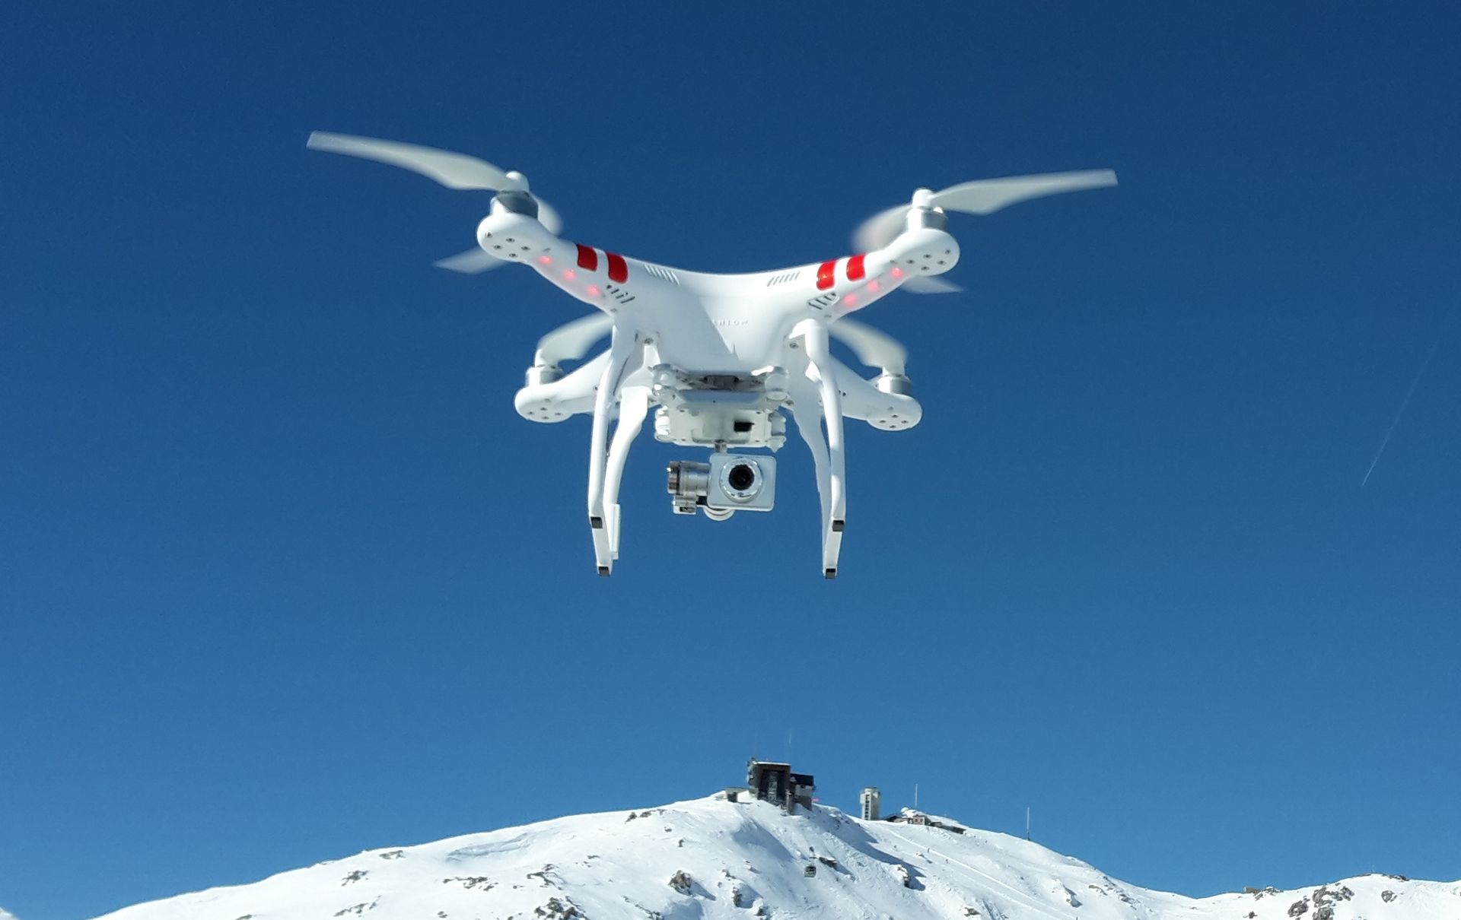
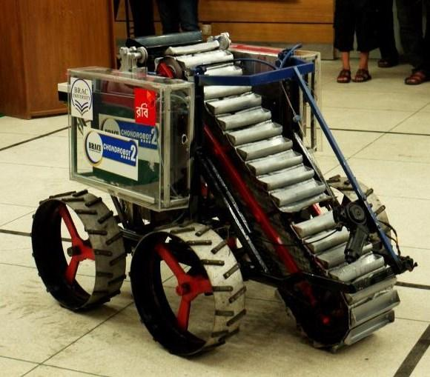
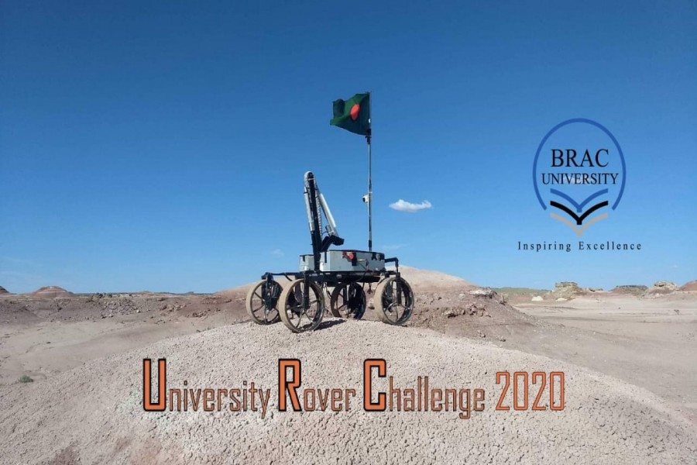
Remote control vehicle (RC)

Slide 13
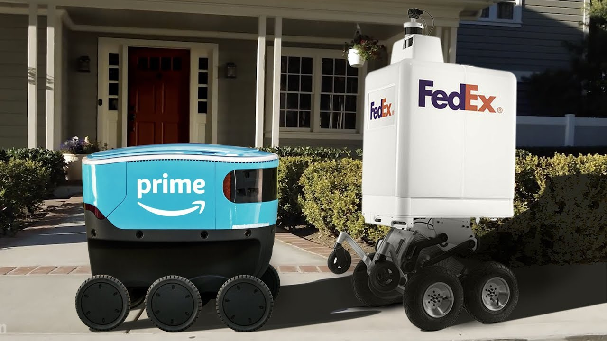
Unmanned ground vehicle (UGV)
https://youtu.be/cZTCmx6N7Xc

Slide 14
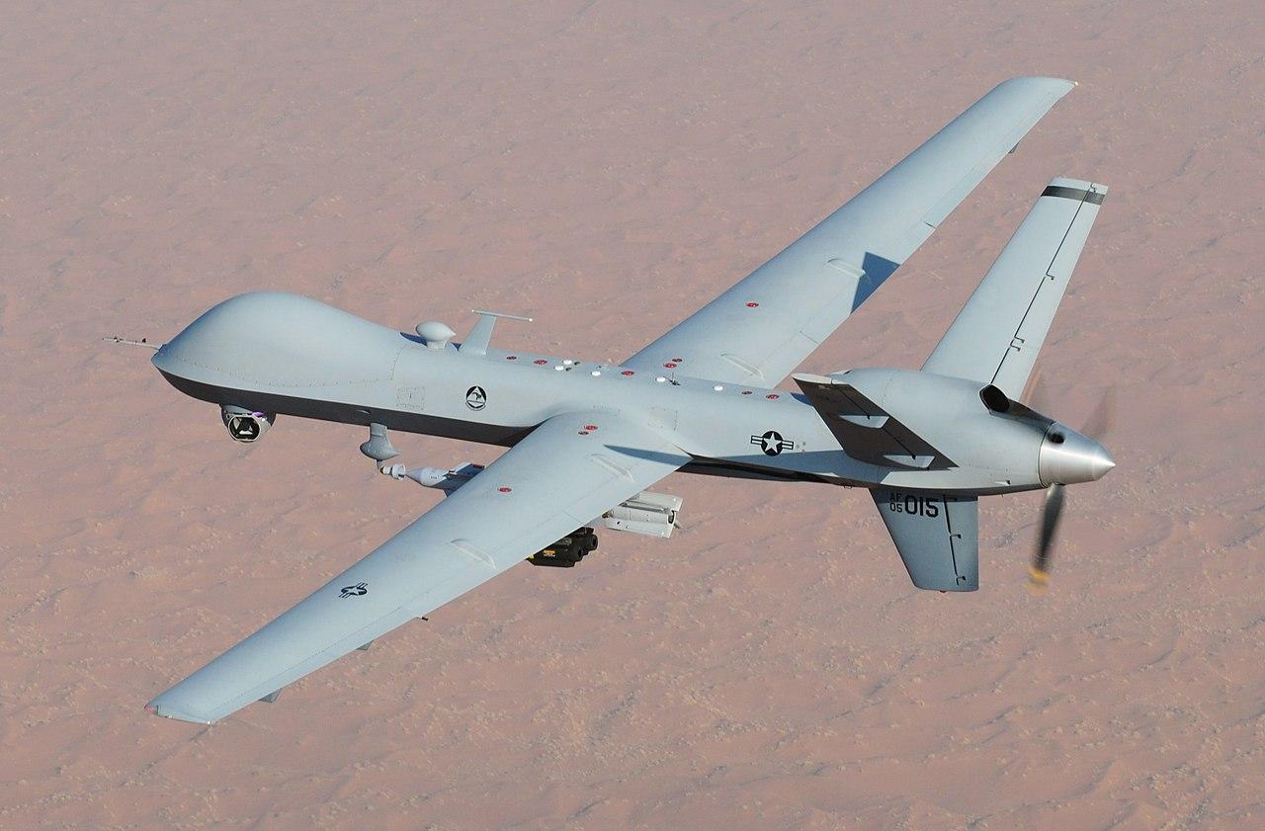
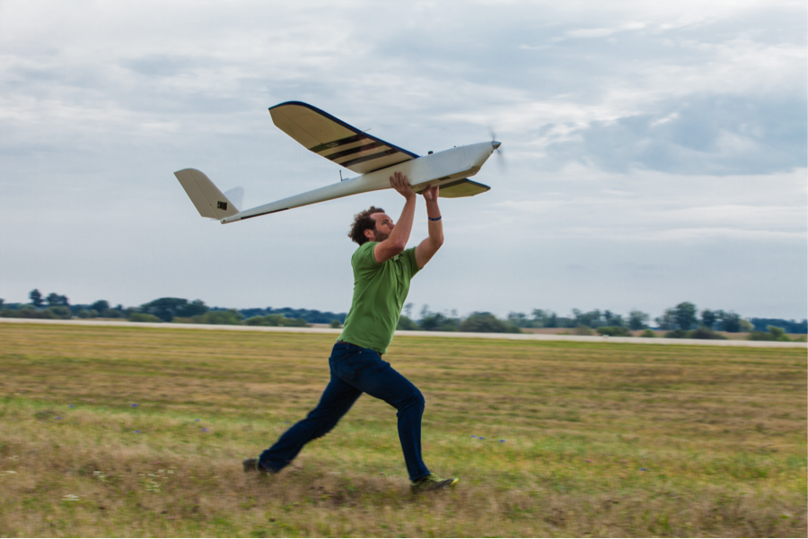
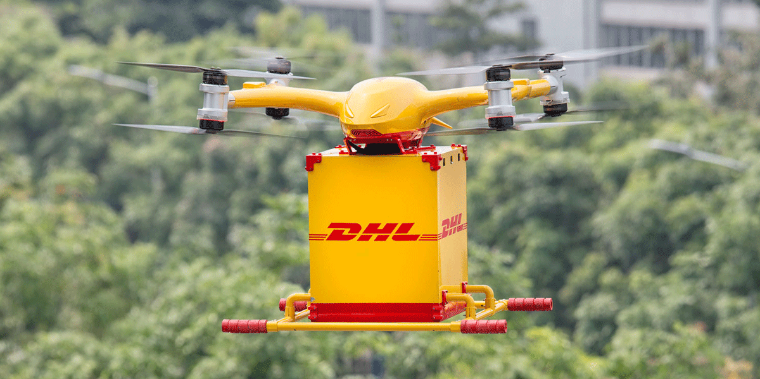
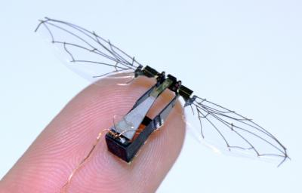
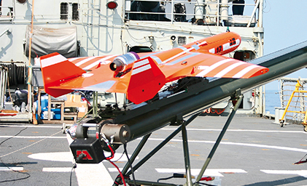
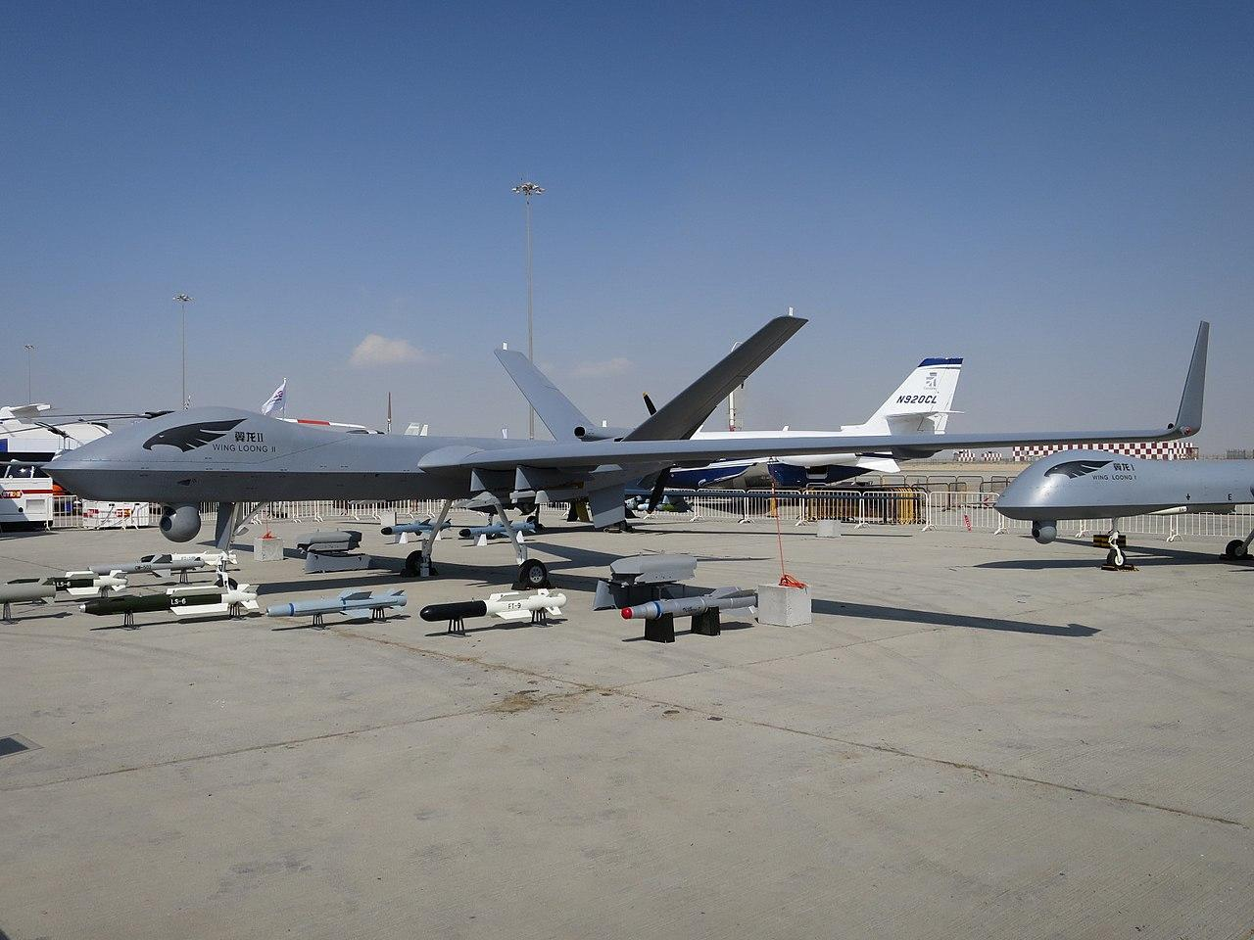
Unmanned aerial vehicle (UAV)
Unmanned combat aerial vehicle (UCAV)
Miniature UAV (SUAV)
Delivery drone
Micro air vehicle (MAV)
Target drone

Slide 15
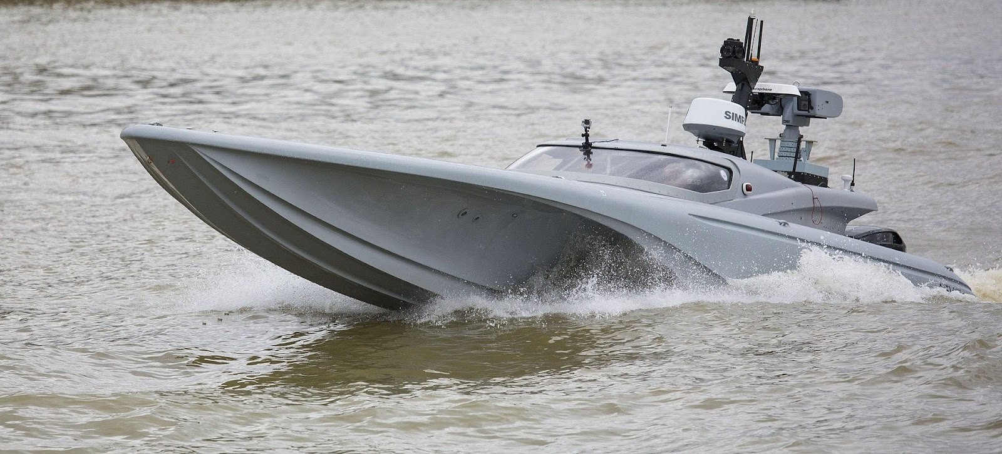
Unmanned surface vehicle (USV)

Slide 16
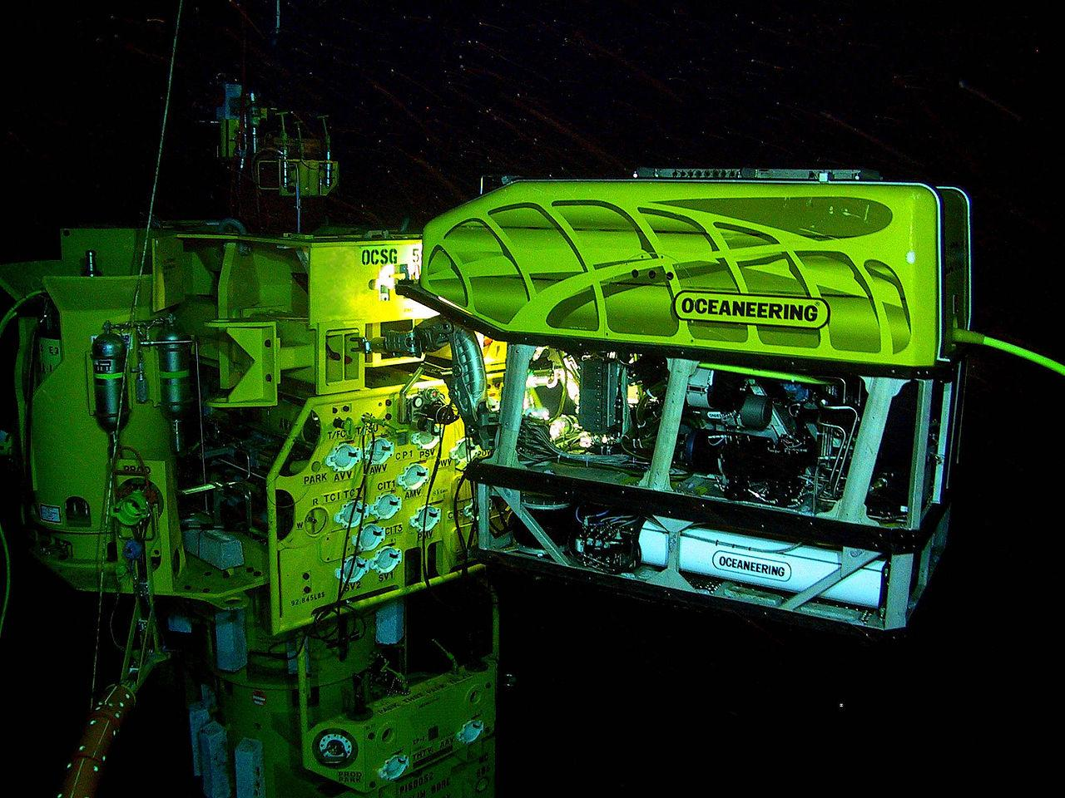
Remotely operated underwater vehicle (ROUV)
https://youtube.com/shorts/rUTZBJArZdM?si=w3tBJUB2ndznAxcz

Slide 17
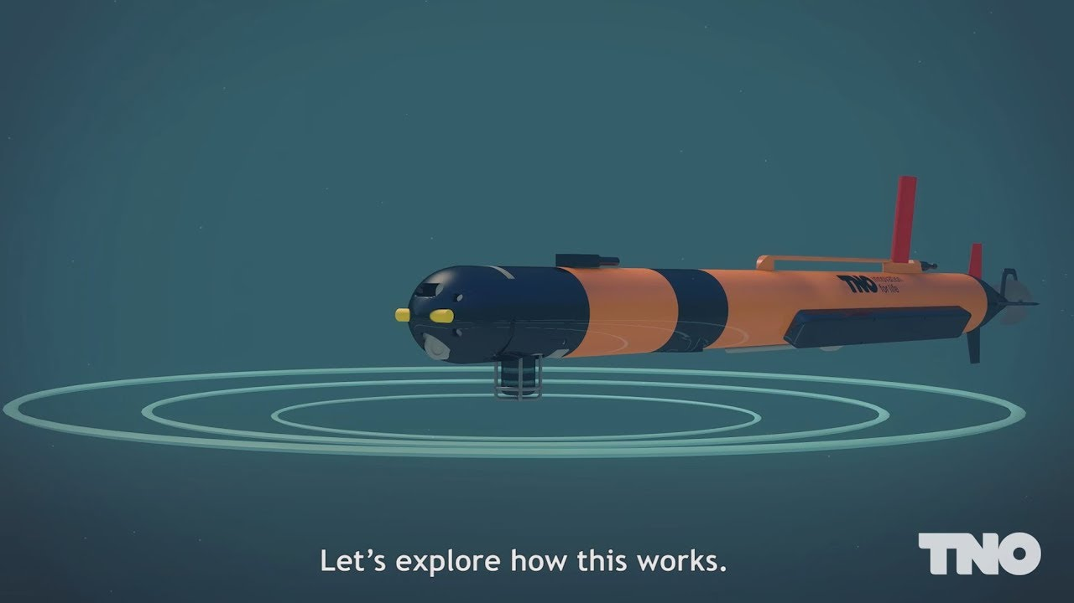
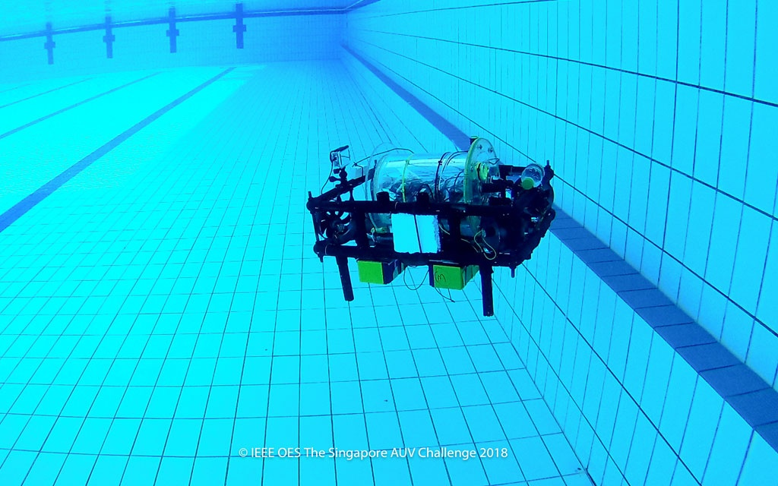
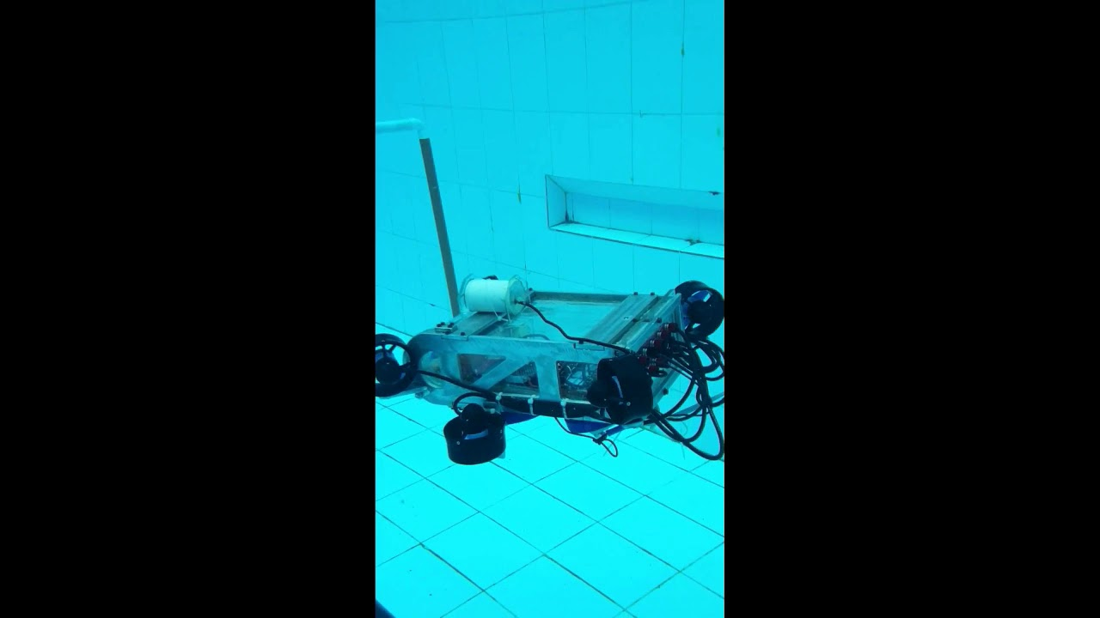
Autonomous underwater vehicle (AUV)

Slide 18
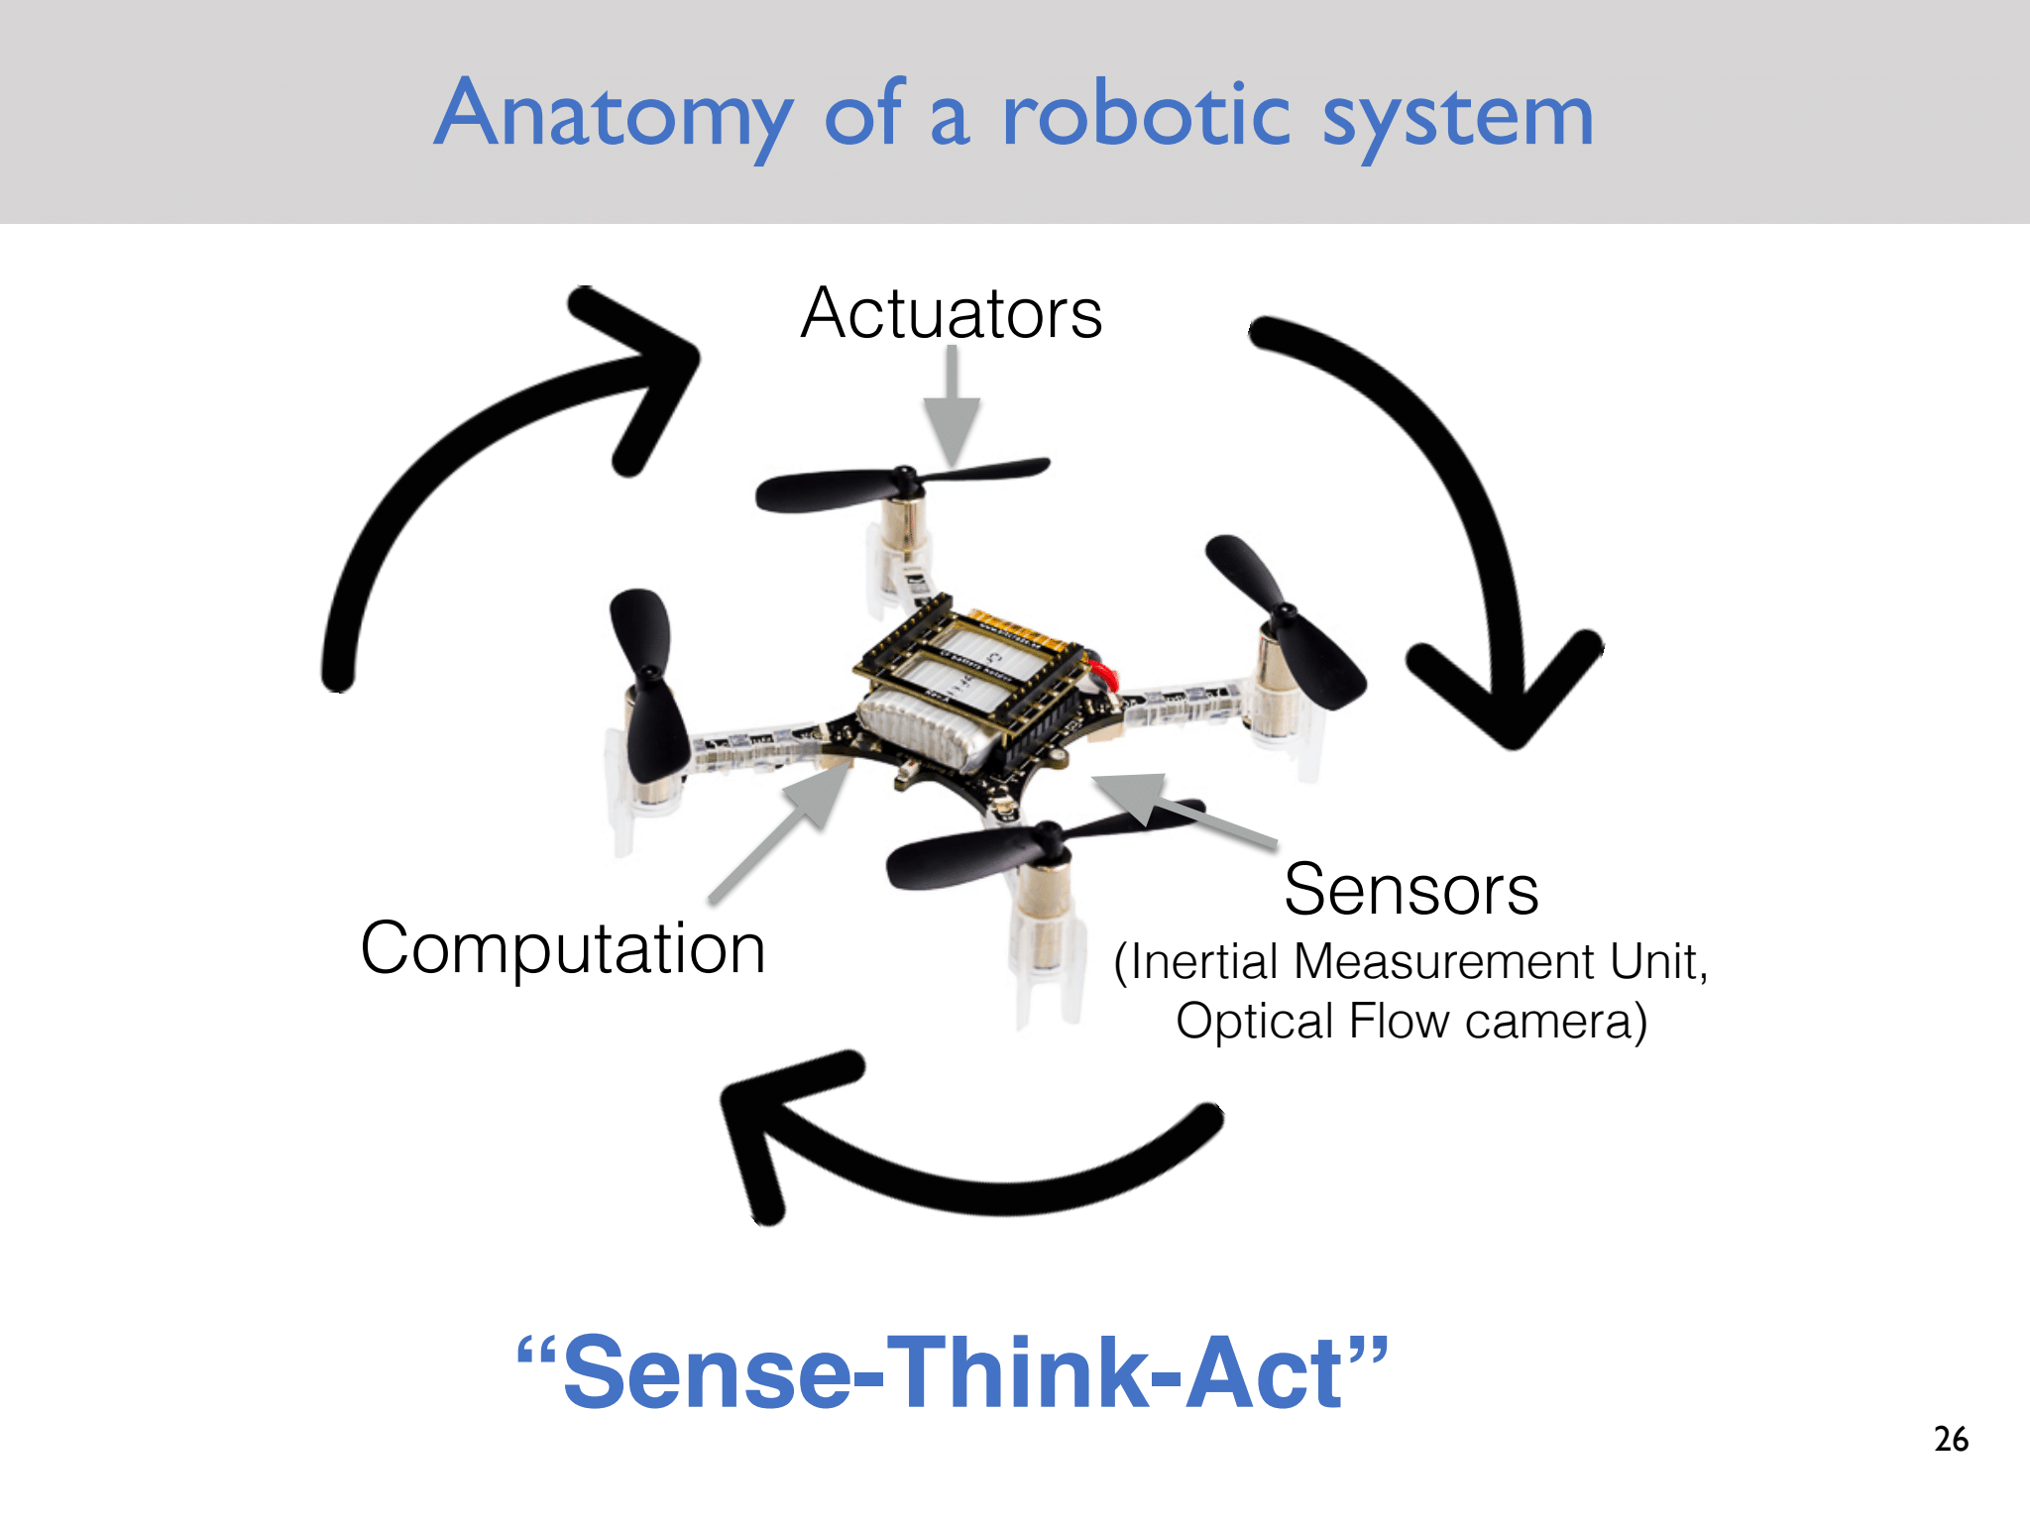

Slide 19
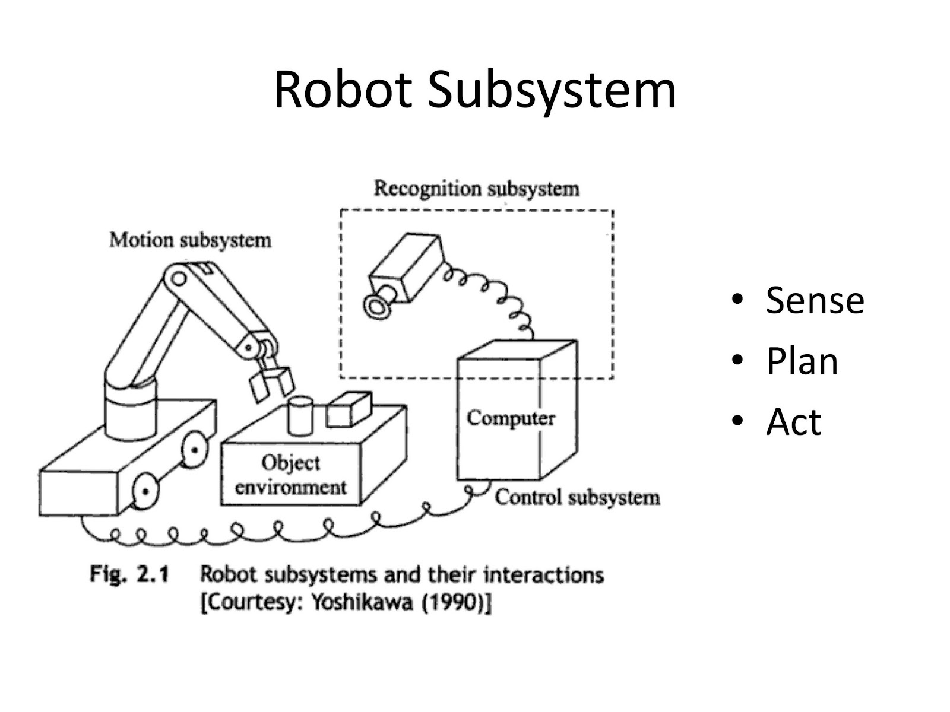
Three primitives of robotics
Notes:
Small step

Slide 20
AI Primitives within an Agent
SENSE
PLAN
ACT
LEARN

Slide 21
Paradigms of Robotics
Notes:
Some standards

Slide 22
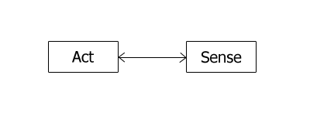
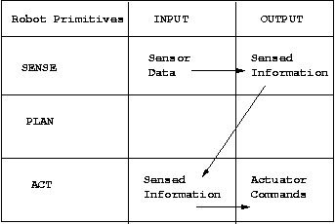
Reactive Paradigm
Notes:
Key Idea: The robot reacts directly to sensor inputs without explicit planning.
Structure:
No complex world model.
Sensing → Immediate Action.
No intermediate "planning" phase.
Example:
The robot detects an obstacle using a proximity sensor.

Slide 23
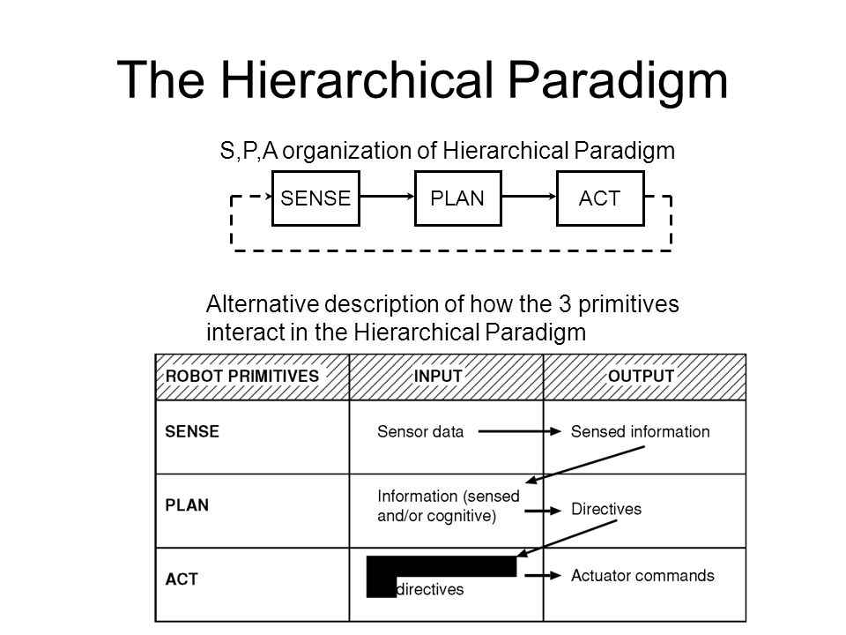
Notes:
Key Idea: The robot follows a structured process: Sense → Plan → Act.
Structure:
Sense: Collects sensor data.
Plan: Processes the information, creates a model of the world, and decides on an action.
Act: Executes the decision.
Self-driving cars (mapping roads and planning safe routes).

Slide 24
Hybrid deliberative/reactive paradigm
PLAN
SENSE
ACT
SENSE
ACT
SENSE
ACT
Notes:
Key Idea: Combines fast reactions (reactive) with intelligent planning (hierarchical).
Structure:
The Planning Module (deliberative) generates high-level strategies.
The Reactive Module quickly responds to environmental changes.
The two modules interact, allowing the robot to be both adaptive and intelligent.
Example:
Autonomous drones (using AI to plan paths while adjusting instantly to obstacles)

Slide 25
Advantages
Asynchronous processing technique allows to function Independently
Planner can slowly compute next goal while robot can perform reactive task
First reactive updates then global panner for planning
Good software Modularity

Slide 26
Local and Global Model
Reactive for Local control
Deliberative for Global control
However; Robot behavioral management requires to know its current mission, state and environment beside path-planning, map-making, monitoring etc. So, both local and global models are required to be considered for a robot performance.

Slide 27
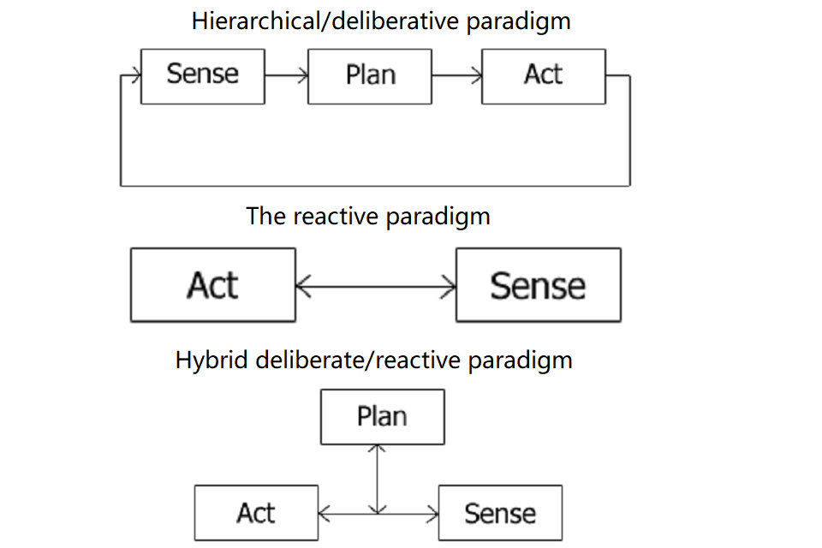

Slide 28
Next Class
Subsystem

Slide 29
Thank You

